Slide 1
CS 467 MachINE LearnIng
Dr. M. Irfan Uddin

Slide 2
CHAPTER 9: Decision Trees

Slide 3
Decision Tree
A decision tree is a hierarchical model for supervised learning whereby the local region is identified in a sequence of recursive splits in a smaller number of steps.
A decision tree is composed of internal decision nodes and terminal leaves

Slide 4
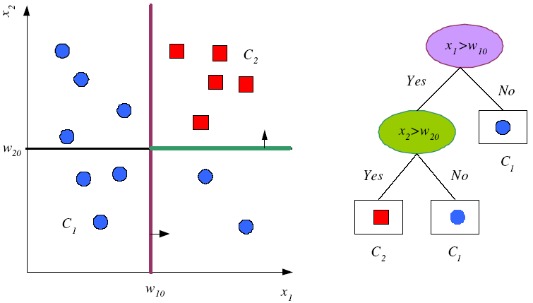
Tree Uses Nodes and Leaves
But this does not look like a tree ☹

Slide 5

This is what a tree look like ☺
Upside down Tree ☺

Slide 6
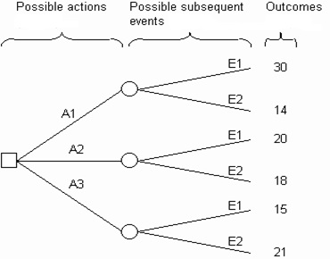
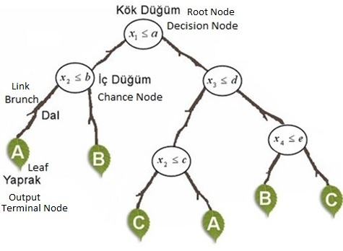
Decision Tree Structure

Slide 7
Divide and Conquer
Internal decision nodes
Univariate: Uses a single attribute, x_{i}
Numeric x_{i} : Binary split : x_{i} > w_{m}
Discrete x_{i} : n-way split for n possible values
Multivariate: Uses all attributes, x
Leaves
Classification: Class labels, or proportions
Regression: Numeric; r average, or local fit
Learning is greedy; find the best split recursively

Slide 8

Decision Tree Example
Debt
Income

Slide 9
Decision Tree Example
Debt
Income > t1
??
t1
Income

Slide 10
Decision Tree Example
Debt
Income > t1
t2
Debt > t2
t1
Income
??

Slide 11
Decision Tree Example
Debt
Income > t1
t2
Debt > t2
t3
t1
Income
Income > t3

Slide 12
Decision Tree Construction
Debt
Income > t1
t2
Debt > t2
t3
t1
Income
Income > t3
Note: tree boundaries are piecewise
linear and axis-parallel

Slide 13
ID3 Algorithm
An algorithm to construct a decision tree
Using Entropy to generate the information gain
The best value then be selected

Slide 14
Top-Down Induction of Decision Trees ID3
A ← the “best” decision attribute for next node
Assign A as decision attribute for node
For each value of A create new descendant
Sort training examples to leaf node according to
the attribute value of the branch
If all training examples are perfectly classified (same value of target attribute) stop, else iterate over new leaf nodes.

Slide 15
Building a Decision Tree
First test all attributes and select the one that would function as the best root;
Break-up the training set into subsets based on the branches of the root node;
Test the remaining attributes to see which ones fit best underneath the branches of the root node;
Continue this process for all other branches until
all examples of a subset are of one type
there are no examples left (return majority classification of the parent)
there are no more attributes left (default value should be majority classification)

Slide 16
Decision Tree for Playing Tennis
Consider the following table
Day | Outlook | Temp. | Humidity | Wind | Play Tennis
D1 | Sunny | Hot | High | Weak | No
D2 | Sunny | Hot | High | Strong | No
D3 | Overcast | Hot | High | Weak | Yes
D4 | Rain | Mild | High | Weak | Yes
D5 | Rain | Cool | Normal | Weak | Yes
D6 | Rain | Cool | Normal | Strong | No
D7 | Overcast | Cool | Normal | Weak | Yes
D8 | Sunny | Mild | High | Weak | No
D9 | Sunny | Cold | Normal | Weak | Yes
D10 | Rain | Mild | Normal | Strong | Yes
D11 | Sunny | Mild | Normal | Strong | Yes
D12 | Overcast | Mild | High | Strong | Yes
D13 | Overcast | Hot | Normal | Weak | Yes
D14 | Rain | Mild | High | Strong | No

Slide 17
Decision Tree for Playing Tennis
We want to build a decision tree for the tennis matches
The schedule of matches depend on the weather (Outlook, Temperature, Humidity, and Wind)
So, to apply what we know to build a decision tree based on this table

Slide 18
Decision Tree for Playing Tennis
Calculating the information gains for each of the weather attributes:
For the Wind
For the Humidity
For the Outlook
For the Temperature

Slide 19
Decision Tree for Playing Tennis
Attributes and their values:
Outlook: Sunny, Overcast, Rain
Humidity: High, Normal
Wind: Strong, Weak
Temperature:Hot,Mild,Cold
Target concept - Play Tennis: Yes, No

Slide 20
Decision Tree for Playing Tennis
Outlook
Sunny
Overcast
Rain
Humidity
Yes
Wind
High
Normal
Strong
Weak
No
Yes
No
Yes

Slide 21
Complete Tree
Outlook
Sunny
Overcast
Rain
Humidity
Yes
Wind
[D3,D7,D12,D13]
High
Normal
Strong
Weak
No
Yes
No
Yes
[D1,D2]
[D8,D9,D11]
[D6,D14]
[D4,D5,D10]

Slide 22
OR Complete Tree
Humidity
Normal
High
Wind
Wind
Strong
Weak
Strong
Weak
Outlook
Outlook
Outlook
Outlook
Sunny
Overcast
Rainy
Sunny
Overcast
Rainy
22
Rainy
Sunny
Overcast
Sunny
Overcast
Rainy

Slide 23
Decision Trees are a good solution but not optimum.
To obtain an optimum decision tree a rule is needed.
We need to find the root node according to some calculations (Entropy & Gain).
After find the root node it will continue up to leaves.
https://towardsdatascience.com/decision-trees-for-classification-id3-algorithm-explained-89df76e72df1

Slide 24
Steps for a desion tree construction:
Decision tree needs a decision (Go to Play Tennis or not)
Entropy calculation of the system
Root Node selection (according to Information Gain)

Slide 25
Entropy & Gain
Determining which attribute is best (Entropy & Gain)
Entropy (E) is the minimum number of bits needed in order to classify an arbitrary example as yes or no
E(S) = Σ^{c}_{i=1} –p_{i} log₂ p_{i}
E(S)=0 , if all variables are the same
E(S)=1 , if variables are distributed equally.
0<E(S)<1 , if variables are distributed randomly.
S means the the training dataset
The information gain G(S,A) where A is an attribute
G(S,A) ≡ E(S) - Σ_{v in Values(A)} (|S_{v}| / |S|) * E(S_{v})
Or simply G(S,A) = E(S) – E(S/A)

Slide 26
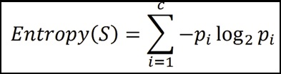
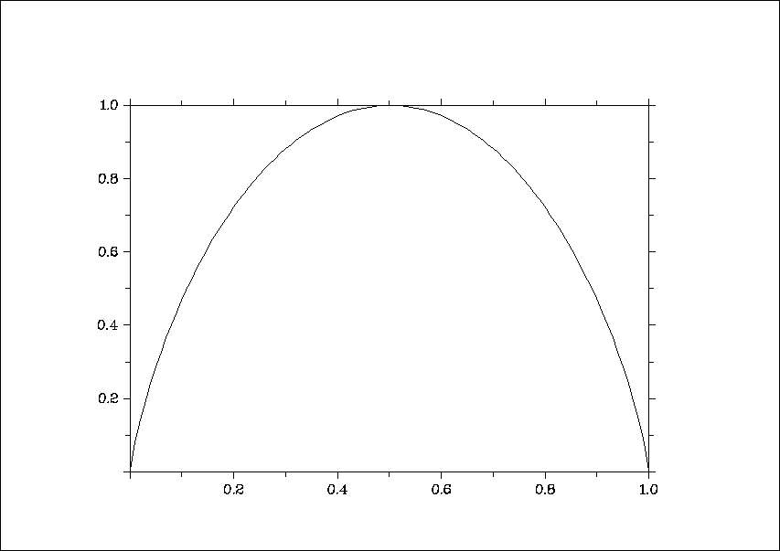
Entropy
The average amount of information I needed to classify an object is given by the entropy measure
Where S is a set of training examples,
c is the number of classes, and
p_{i} is the proportion of the training set that is of class i
Zero Entropy occurs when the entire set is from one class
0 log₂ 0 = 0 also 1 log₂ 1 = 0
Also it can be written as: E(S) = -(p+)*log₂(p+ ) - (p_ )*log₂(p_ )
Where p+ is the positive samples
Where p_ is the negative samples
Where S is the sample of attributions
For a two-class problem:
For more than 2-classes, E can be greater than 1
entropy
p(c1)

Slide 27
Example
[29+,35-]
A₁=?
The Entropy of A₁ is computed as the following:
E(A) = -29/(29+35)*log2(29/(29+35)) –
35/(35+29)log2(35/(35+29))
= 0.9937
E(TRUE) = -21/(21+5)*log2(21/(21+5)) – 5/(5+21)*log2(5/(5+21))= 0.7960
E(FALSE) = -8/(8+30)*log2(8/(8+30)) –
30/(30+8)*log2(30/(30+8))
= 0.7426
True
False
The Entropy of True:
[21+, 5-]
[8+, 30-]
The Entropy of False:

Slide 28




Entropy reduction by data set partitioning
.
.
.
.
.
.
.
.
red
Color?
green
.
yellow
.
.
.
*I means Information Entropy

Slide 29






.
.
.
.
.
.
red
.
.
Color?
green
yellow
.
.
.
.
IG(S, Color) = I(S) – I(S/Color)
= I(S) – [red/total * I_{red} + green/total * I_{green} + yellow/total * I_{yellow}]

Slide 30
Information Gain
.
.
.
.
.
.
.
.
red
Color?
green
.
yellow
.
.
.
Tutorial: https://machinelearningmastery.com/information-gain-and-mutual-information/

Slide 31
Information Gain of The Attribute
Attributes
Gain(Color) = 0.246
Gain(Outline) = 0.151
Gain(Dot) = 0.048
Heuristics: attribute with the highest gain is chosen
This heuristics is local (local minimization of impurity)
Highest IG suggests a lower entropy and a high entropy can result into lower IG

Slide 32
.
.
.
.
.
.
.
.
red
Color?
green
.
yellow
.
.
.
Gain(Outline) = 0.971 – 0 = 0.971 bits
Gain(Dot) = 0.971 – 0.951 = 0.020 bits

Slide 33
.
.
.
.
.
.
.
.
red
Color?
Gain(Outline) = 0.971 – 0.951 = 0.020 bits
Gain(Dot) = 0.971 – 0 = 0.971 bits
green
.
yellow
.
.
.
solid
.
Outline?
dashed
.

Slide 34
.
.
.
.
.
.
.
.
red
.
yes
Dot?
.
Color?
no
green
.
yellow
.
.
.
solid
.
Outline?
dashed
.

Slide 35
Decision Tree
.
.
.
.
.
.
Color
red
green
yellow
Dot
square
Outline
yes
no
dashed
solid
triangle
square
triangle
square

Slide 36
Which Attribute is ”best”?
[29+,35-]
A₁=?
A₂=?
[29+,35-]
True
False
True
False
[21+, 5-]
[8+, 30-]
[18+, 33-]
[11+, 2-]

Slide 37
Information Gain
Entropy([18+,33-]) = 0.94
Entropy([8+,30-]) = 0.62
Gain(S,A₂)=Entropy(S)
-51/64*Entropy([18+,33-])
-13/64*Entropy([11+,2-])
=0.12
Entropy([21+,5-]) = 0.71
Entropy([8+,30-]) = 0.74
Gain(S,A₁)=Entropy(S)
-26/64*Entropy([21+,5-])
-38/64*Entropy([8+,30-])
=0.27
[29+,35-]
A₁=?
A₂=?
[29+,35-]
True
False
True
False
[21+, 5-]
[8+, 30-]
[18+, 33-]
[11+, 2-]

Slide 38
Playing Tennis or Not Example Calculations
Day
Outlook
Temp.
Humidity
Wind
Play Tennis
D1
Sunny
Hot
High
Weak
No
D2
Sunny
Hot
High
Strong
No
D3
Overcast
Hot
High
Weak
Yes
D4
Rain
Mild
High
Weak
Yes
D5
Rain
Cool
Normal
Weak
Yes
D6
Rain
Cool
Normal
Strong
No
D7
Overcast
Cool
Normal
Weak
Yes
D8
Sunny
Mild
High
Weak
No
D9
Sunny
Cold
Normal
Weak
Yes
D10
Rain
Mild
Normal
Strong
Yes
D11
Sunny
Mild
Normal
Strong
Yes
D12
Overcast
Mild
High
Strong
Yes
D13
Overcast
Hot
Normal
Weak
Yes
D14
Rain
Mild
High
Strong
No

Slide 39
Let
E([X+,Y-]) represent that there are X positive training elements and Y negative elements.
Therefore, the Entropy for the training data, E(S), can be represented as E([9+,5-]) because of the 14 training examples 9 of them are yes and 5 of them are no.
Let’s start off by calculating the Entropy of the Training Set.
E(S) = E([9+,5-]) = (-9/14 log₂ 9/14) + (-5/14 log₂ 5/14)
= 0.94
Next we will need to calculate the information gain G(S,A) for each attribute A where A is taken from the set {Outlook, Temperature, Humidity, Wind}.

Slide 40
Selecting the Next Attribute
S=[9+,5-]
E=0.940
Outlook
Over
cast
Sunny
Rain
[2+, 3-]
[4+, 0]
[3+, 2-]
E=0.971
E=0.0
E=0.971
Gain(S, Outlook)
=0.940 - (5/14)*0.971 - (4/14)*0.0 - (5/14)*0.0971
=0.247

Slide 41
The information gain for Outlook is:
G(S,Outlook) = E(S) – [5/14 * E(Outlook=sunny) + 4/14 * E(Outlook = overcast) +
5/14 * E(Outlook=rain)]
G(S,Outlook) = E([9+,5-]) – [5/14*E(2+,3-) + 4/14*E([4+,0-]) + 5/14*E([3+,2-])]
G(S,Outlook) = 0.94 – [5/14*0.971 + 4/14*0.0 + 5/14*0.971]
G(S,Outlook) = 0.246
G(S,Temperature) = 0.94 – [4/14*E(Temperature=hot) +6/14*E(Temperature=mild) + 4/14*E(Temperature=cool)]
G(S,Temperature) = 0.94 – [4/14*E([2+,2-]) + 6/14*E([4+,2-]) + 4/14*E([3+,1-])]
G(S,Temperature) = 0.94 – [4/14 + 6/14*0.918 + 4/14*0.811]
G(S,Temperature) = 0.029

Slide 42
Selecting the Next Attribute
S=[9+,5-]
E=0.940
S=[9+,5-]
E=0.940
Humidity
Wind
High
Normal
Weak
Strong
[3+, 4-]
[6+, 1-]
[6+, 2-]
[3+, 3-]
E=0.592
E=0.811
E=0.985
E=1.0
Gain(S,Humidity)
=0.940-(7/14)*0.985
– (7/14)*0.592
=0.151
Gain(S,Wind)
=0.940-(8/14)*0.811
– (6/14)*1.0
=0.048
Humidity provides greater info. gain than Wind, w.r.t target classification.

Slide 43
G(S,Humidity) = 0.94 – [7/14*E(Humidity=high) + 7/14*E(Humidity=normal)]
G(S,Humidity = 0.94 – [7/14*E([3+,4-]) + 7/14*E([6+,1-])]
G(S,Humidity = 0.94 – [7/14*0.985 + 7/14*0.592]
G(S,Humidity) = 0.1515
G(S,Wind) = 0.94 – [8/14*0.811 + 6/14*1.00]
G(S,Wind) = 0.048

Slide 44
Selecting the Next Attribute
The information gain values for the 4 attributes are:
Gain(S,Outlook) =0.247
Gain(S,Humidity) =0.151
Gain(S,Wind) =0.048
Gain(S,Temperature) =0.029
where S denotes the collection of training examples

Slide 45
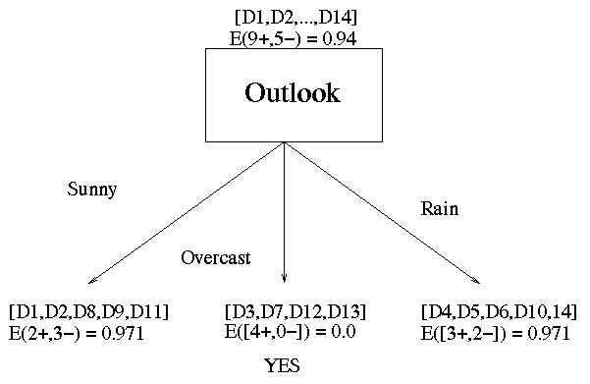
Decision Tree Learning: A Simple Example
Outlook is our winner!

Slide 46
Now that we have discovered the root of our decision tree
We must now recursively find the nodes that should go below Sunny, Overcast, and Rain.
G(Outlook=Rain, Humidity) = 0.971 – [2/5*E(Outlook=Rain ^ Humidity=high) + 3/5*E(Outlook=Rain ^Humidity=normal]
G(Outlook=Rain, Humidity) = 0.02
G(Outlook=Rain, Wind) = 0.971- [3/5*0 + 2/5*0]
G(Outlook=Rain, Wind) = 0.971
G(Outlook=Rain, Temperature) = 0.02

Slide 47
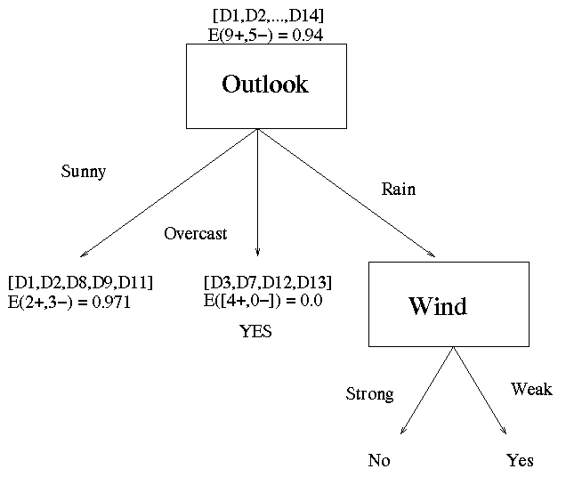
When Rain, then Wind is winner
Now our decision tree looks like:
E(Outlook=Overcast) = 0.0
Make it as leaf node

Slide 48
ID3 Algorithm
Note: 0Log₂0 =0
[D1,D2,…,D14]
[9+,5-]
Outlook
Sunny
Overcast
Rain
S_{sunny}=[D1,D2,D8,D9,D11]
[2+,3-]
[D3,D7,D12,D13]
[4+,0-]
[D4,D5,D6,D10,D14]
[3+,2-]
?
Yes
Wind
Test for this node
Gain(S_{sunny} , Humidity)=0.970-(3/5)0.0 – 2/5(0.0) = 0.970
Gain(S_{sunny} , Temp.)=0.970-(2/5)0.0 –2/5(1.0)-(1/5)0.0 = 0.570
Gain(S_{sunny} , Wind)=0.970= -(2/5)1.0 – 3/5(0.918) = 0.019

Slide 49
ID3 Algorithm
Outlook
Sunny
Overcast
Rain
Humidity
Yes
Wind
[D3,D7,D12,D13]
High
Normal
Strong
Weak
No
Yes
No
Yes
[D1,D2]
[D8,D9,D11]
[D6,D14]
[D4,D5,D10]

Slide 50
Converting a Tree to Rules
Outlook
Sunny
Overcast
Rain
Humidity
Yes
Wind
High
Normal
Strong
Weak
No
Yes
No
Yes
R₁: If (Outlook=Sunny) ∧ (Humidity=High) Then PlayTennis=No
R₂: If (Outlook=Sunny) ∧ (Humidity=Normal) Then PlayTennis=Yes
R₃: If (Outlook=Overcast) Then PlayTennis=Yes
R₄: If (Outlook=Rain) ∧ (Wind=Strong) Then PlayTennis=No
R₅: If (Outlook=Rain) ∧ (Wind=Weak) Then PlayTennis=Yes

Slide 51
Decision Tree for PlayTennis
Outlook
Sunny
Overcast
Rain
Humidity
Each internal node tests an attribute
High
Normal
Each branch corresponds to an
attribute value node
No
Yes
Each leaf node assigns a classification

Slide 52
Decision Tree for PlayTennis
Outlook Temperature Humidity Wind PlayTennis
Sunny Hot High Weak ?
No
Outlook
Sunny
Overcast
Rain
Humidity
Yes
Wind
High
Normal
Strong
Weak
No
Yes
No
Yes

Slide 53
Decision Tree for Conjunction
Outlook=Sunny ∧ Wind=Weak
Outlook
Sunny
Overcast
Rain
Wind
No
No
Strong
Weak
No
Yes

Slide 54
Decision Tree for Disjunction
Outlook=Sunny ∨ Wind=Weak
Outlook
Sunny
Overcast
Rain
Yes
Wind
Wind
Strong
Weak
Strong
Weak
No
Yes
No
Yes

Slide 55
Decision Tree
Decision trees represent disjunctions of conjunctions
Outlook
Sunny
Overcast
Rain
Humidity
Yes
Wind
High
Normal
Strong
Weak
No
Yes
No
Yes
(Outlook=Sunny ∧ Humidity=Normal)
∨ (Outlook=Overcast)
∨ (Outlook=Rain ∧ Wind=Weak)

Slide 56
Advantages/Disadvantages of Decision Trees
Advantages
Easy construction
Simple to understand and interpret
Understandable rules can be obtained.
Requires little data preparation.(Other techniques often require data normalisation, dummy variables need to be created and blank values to be removed)
Disadvantages
Lots of class makes it hard to predict or learn.
Both construction and deconstruction is so high that it causes confusion for learning.

Slide 57
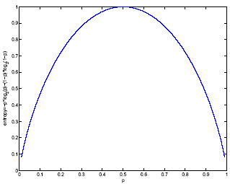
Classification Trees (ID3,CART,C4.5)
For node m, N_{m} instances reach m, N^{i}_{m} belong to C_{i}
Node m is pure if p^{i}_{m} is 0 or 1
Measure of impurity is entropy

Slide 58
Best Split
If node m is pure, generate a leaf and stop, otherwise split and continue recursively
Impurity after split: N_{mj} of N_{m} take branch j. N^{i}_{mj} belong to C_{i}
Find the variable and split that min impurity (among all variables -- and split positions for numeric variables)

Slide 59
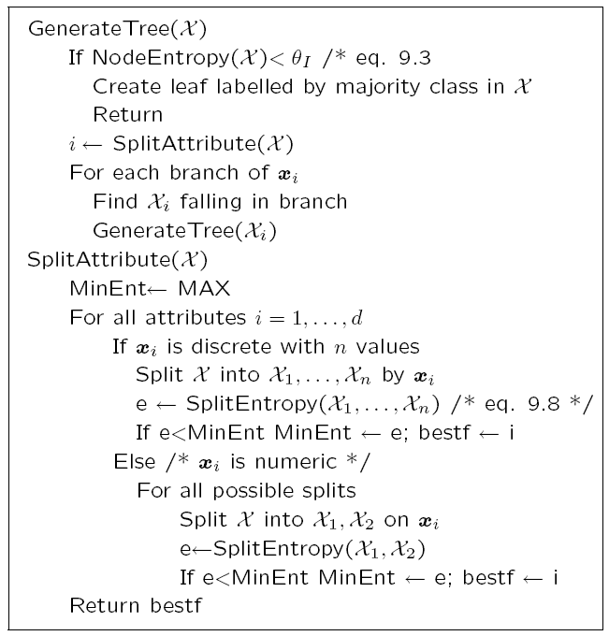

Slide 60
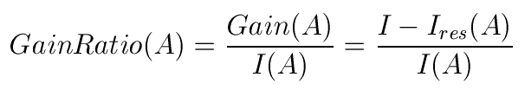



Other Impurity Measures
ID3
C4.5
CART
GiniGain(A) = Gini – Gini(A)

Slide 61
Regression Trees
A regression tree is constructed in almost the same manner as a classification tree, except that the impurity measure that is appropriate for classification is replaced by a measure appropriate for regression.
Error at node m:
After splitting:

Slide 62
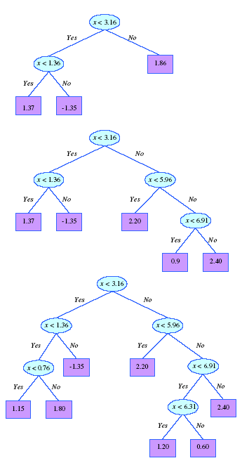
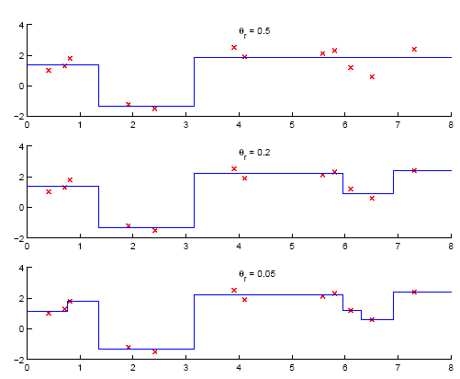
Model Selection in Trees

Slide 63
Pruning Trees
Remove subtrees for better generalization (decrease variance)
Prepruning: Early stopping
Postpruning: Grow the whole tree then prune subtrees that overfit on the pruning set
Prepruning is faster, postpruning is more accurate (requires a separate pruning set)
Pruning: For example, in the third tree on previous slide, there is a subtree starting with condition x < 6.31. This subtree can be replaced by a leaf node of y = 0.9 (as in the second tree) if the error on the pruning set does not increase during the substitution.

Slide 64
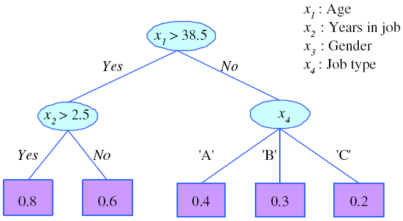
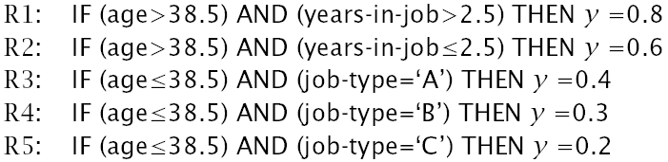
Rule Extraction from Trees
C4.5Rules
(Quinlan, 1993)

Slide 65
Learning Rules
Rule induction is similar to tree induction but
tree induction is breadth-first,
rule induction is depth-first; one rule at a time
Rule set contains rules; rules are conjunctions of terms
Rule covers an example if all terms of the rule evaluate to true for the example
Sequential covering: Generate rules one at a time until all positive examples are covered
IREP (Fürnkrantz and Widmer, 1994), Ripper (Cohen, 1995)

Slide 66
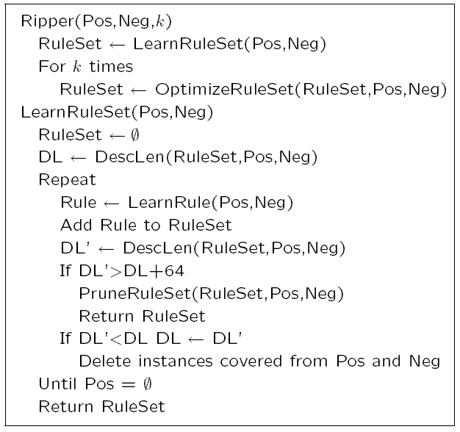

Slide 67
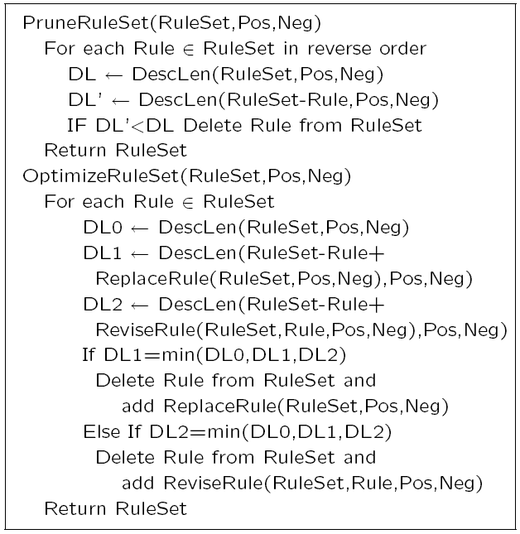

Slide 68
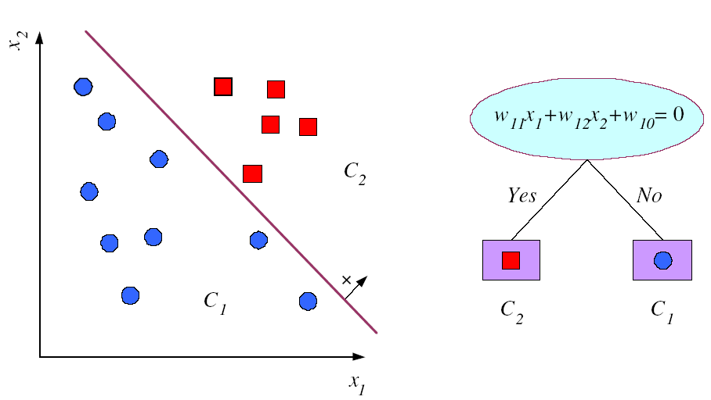
Multivariate Trees

Slide 69
Assignment # 9
https://www.kaggle.com/code/jebathuraiibarnabas/decision-tree-id3-from-scratch

